Slide 1
Google AdWords and Generalized Second-Price Auction

Slide 2
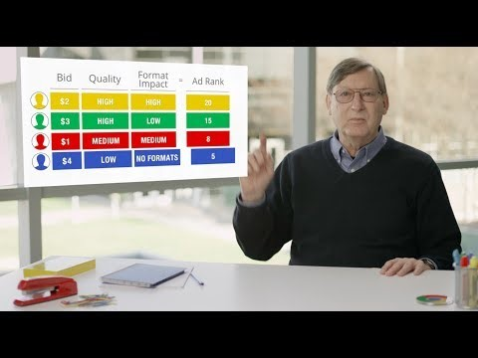
Google AdWords System

Slide 3
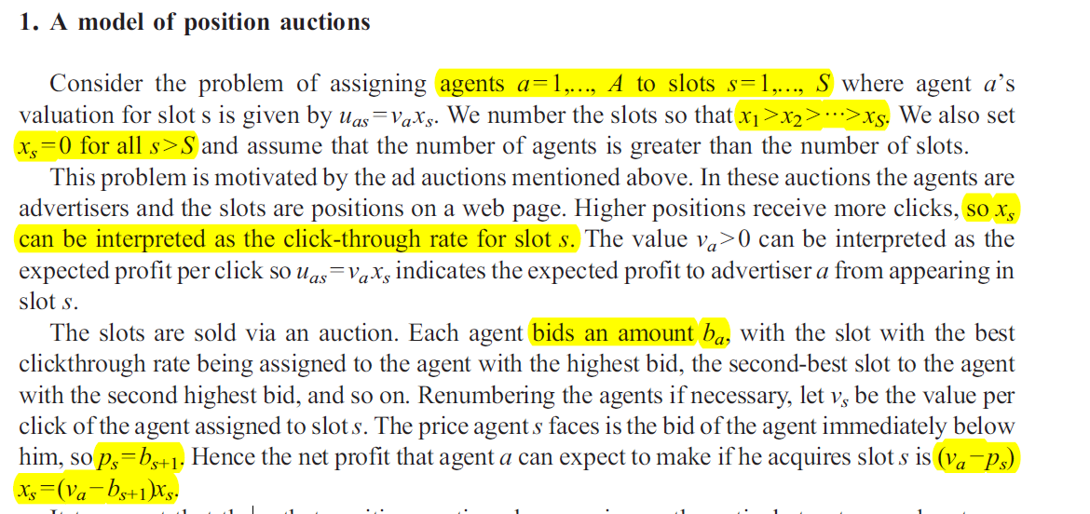
Model Setup

Slide 4
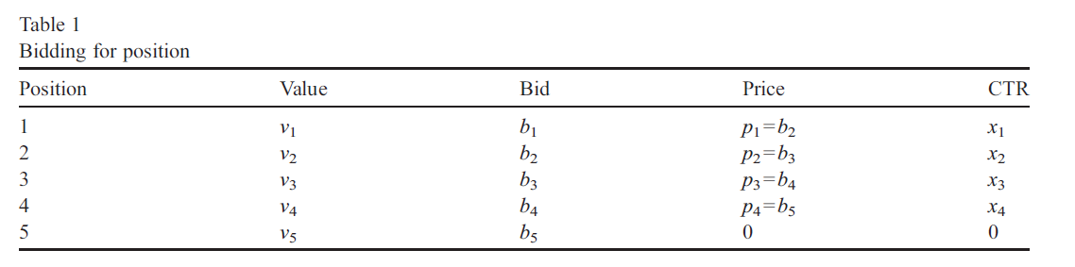
If agent 3 wanted to move up by one position, it would have to bid at least b2, the bid of agent 2.
But if agent 2 wanted to move down by one position it would only have bid at least b4=p3, the bid of agent 4.
Notes:
We see that to move to a higher slot you have to beat the bid that the agent who currently occupies that slot is making; to move to a lower slot you only have to beat the price that the agent who currently occupies that slot is paying.

Slide 5
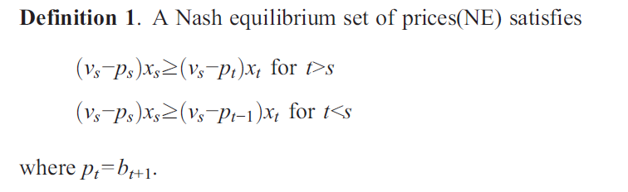
Nash Equilibirum
Notes:
In equilibrium, each agent should prefer his current slot to any other slot, which motivates the following definition.
2) Note that if an agent changes his bid slightly it normally won't affect his position or payment, so there will typically be a range of bids and prices that satisfy these inequalities.
3) Also note that these inequalities are linear in the prices. Hence, given (vs) and (xs) we can use a simple linear program to solve for the maximum and minimum equilibrium revenue attainable by the auction.

Slide 6
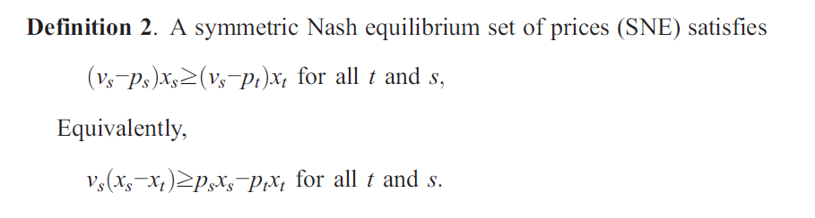
Nash Equilibirum

Slide 7
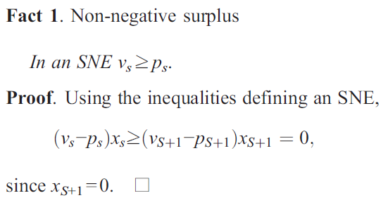
Facts of this model

Slide 8
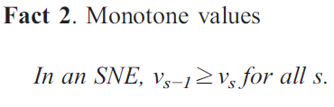
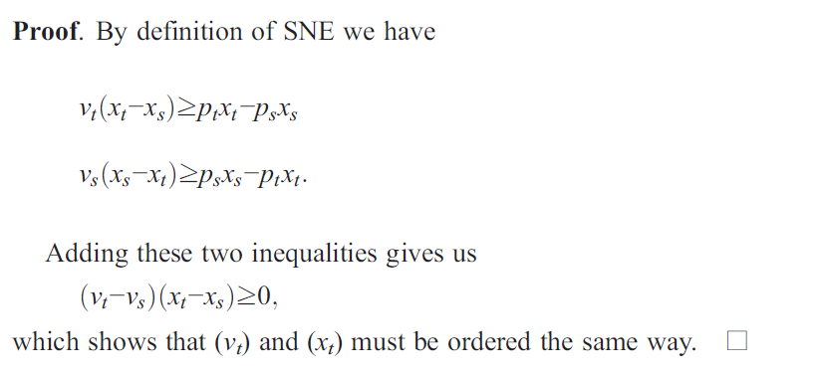
Facts of this model
Notes:
Note that since agents with higher values are assigned to better slots, an SNE is an efficient
allocation.

Slide 9
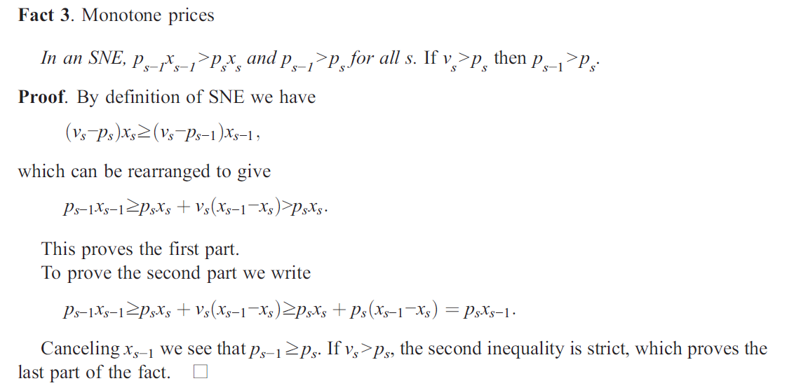
Facts of this model

Slide 10
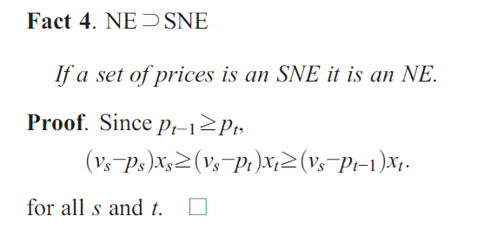
Facts of this model

Slide 11
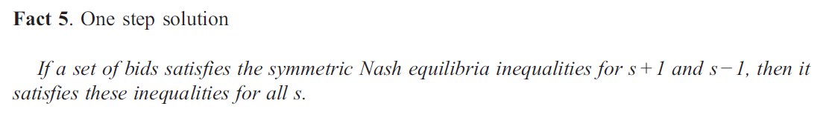
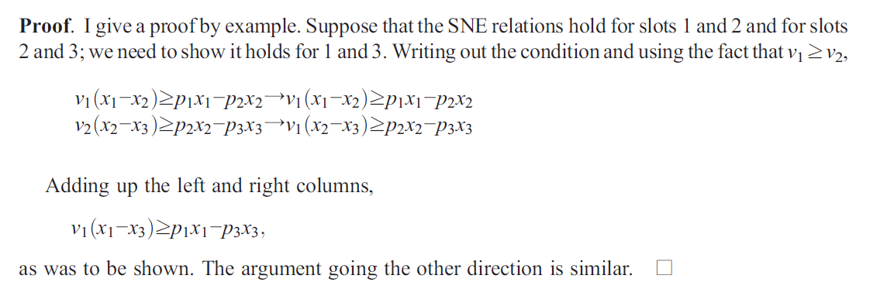
Facts of this model

Slide 12



NE solution
For position S
For position S+1
Putting together
Boundaries for bids

Slide 13
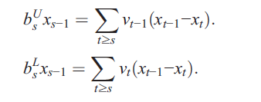

NE solution
Similar to VCG mechanism
Sum up
Since Xs=0 for s>S,
Do s=S+1
it is optimal for the first excluded bidder to bid his value
Notes:
so that it is optimal for the first excluded bidder to bid his value. This result has the same argument as in the usual Vickrey auction. If you are excluded, then bidding lower than your value is pointless, but if you do happen to be shown (e.g., because one of the higher bidders drops out) you will make a profit.

Slide 14
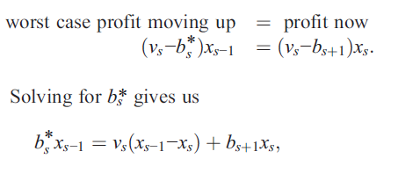
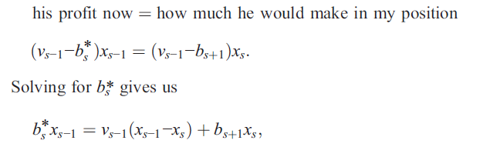
Logic of the bounds
Lower-bound
upper-bound
Notes:
1) What is the highest bid I can set so that if I happen to exceed the bid of the agent above me and I move up by one slot, I am sure to make at make at least as much profit as I make now?
The worst case is where I just beat the advertiser above me by a tiny amount and end up paying my bid, bs, minus a tiny amount. Hence the break even case satisfies the equation
2) Alternatively, we can think defensively. If I set my bid too high, I will squeeze the profit of the player ahead of me so much that he might prefer to move down to my position. The highest breakeven bid that would not induce the agent above me to move down is

Slide 15
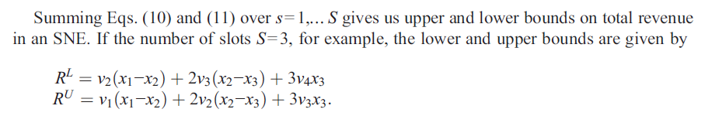
Facts of this model

Slide 16




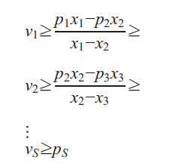
Bounds on values
Notes:
These inequalities have a nice interpretation: the ratios are simply the incremental cost of moving up or down one position.
1. The inequalities give an observable necessary condition for a the existence of a pure strategyNash equilibrium, namely, that each of the intervals be non-empty. The conditions are also sufficient in
that if the intervals are non-empty, we can find a set of values that are consistent with equilibrium.
2. The inequalities also yield simple bidding rule for the agents: if your value exceeds the marginal cost of moving up a position, then bid higher, stopping when this no longer is true.
3. Finally the inequalities motivate the following intuitive characterization of SNE: the marginal cost of a click must increase as you move to higher positions.Why? Because if it ever decreased, there would be an advertiser who passed up cheap clicks in order to purchase expensive ones.

Slide 17


Graph Illustration

Slide 18
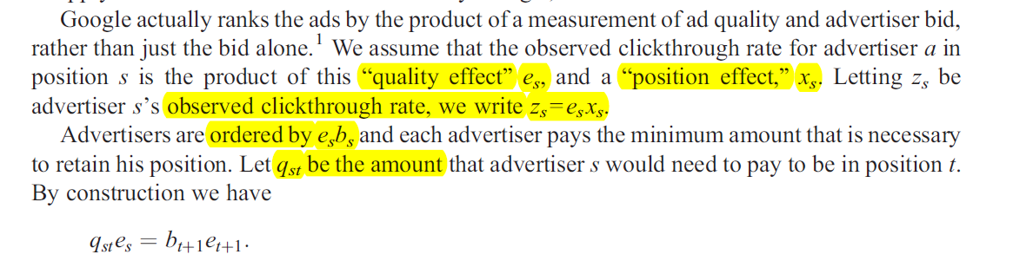
Application to Googles AdWords

Slide 19
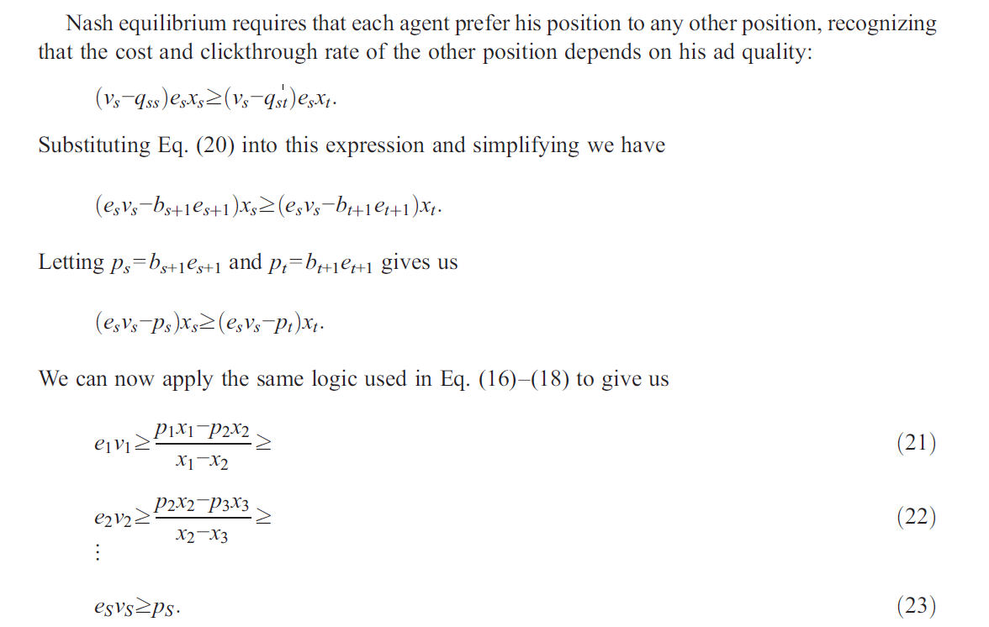
Application to Googles AdWords

